Slide 1
A Markov Chain Model of Military Personnel Dynamics
Mark Zais
Dan Zhang
University of Colorado, Boulder
Leeds School of Business
21 March 2014

Slide 2

Outline
Introduction
Markov Chain Estimation
Dynamic Programming Retention Model
Future Research
Introduction
Background
Contribution
Enlisted Retention Modeling
Markov Chain Estimation
States
Transition Matrix
Transition Probabilities
Validation / Bootstrap C.I.
Interpretation of the Markov Process
Dynamic Programming Retention Model
Notation
Reward and Value Functions
Optimal Policy Index
Integration with Predictive Model
Future Research

Slide 3
Background
Introduction
Markov Chain Estimation
Dynamic Programming Retention Model
Future Research
Background
Contribution
Enlisted Retention Modeling
Current policies for disseminating incentives lack an analytical framework for determining a propensity to serve or an optimal value that will shape a decision.
Army incentive programs frequently target specific skills but offer arbitrary values.
Within military occupation specialties, there is no method of separating individual retention propensity.
Retention incentive programs cannot target individuals based on personal demographics.
Most research related to Army continuation rates and retention behavior rely on career cohort data.
Previous research is heavily segregated between pecuniary and non-pecuniary retention modeling.
It is reasonable to assume individuals make decisions based on monetary compensation and others factors based on experience and attributes.

Slide 4
What is the contribution of this research?
Introduction
Markov Chain Estimation
Dynamic Programming Retention Model
Future Research
Background
Contribution
Enlisted Retention Modeling
Markov properties of the enlisted Army career path can be used to guide policies, which shape the composition of the personnel inventory through measure such as promotion criteria, retention control points and forced reduction measures.
We provide a method for targeting retention programs that resists unpalatable discriminatory policies that focus on personal attributes.
This research provides a more holistic approach, balancing pecuniary and non-pecuniary factors.
This research provides a method for organizations to significantly optimize resources and reduce the cost of shaping personnel inventory.
Objective: Develop a dynamic programming framework to evaluate an individual’s stay or leave decision based on expected future compensation value and integrate the results with non-pecuniary predictive models for a more holistic approach to targeting retention incentives.
Notes:
Unlike traditional classification approaches, the Markov chain model allows us to describe military personnel dynamics over time and answer a variety of typical questions with a shorter range of data and without relying on cohorts.
The transition probability matrix extends as a critical parameter for a stochastic dynamic programming model to target incentives.

Slide 5
Previous Research
Introduction
Markov Chain Estimation
Dynamic Programming Retention Model
Future Research
Background
Contribution
Enlisted Retention Modeling
Gotz and McCall (1983)
Developed a sequential decision making model that focuses on Air Force officers.
Assumed that officers make homogeneous decision; did not incorporate non-pecuniary factors.
Warner and Goldberg (1983)
Developed a non-pecuniary model to analyze the elasticity of reenlistment rates among Navy personnel.
Model focuses on first-term reenlistment decisions.
Model is a simplified version of a traditional DP model using a single state to represent military service.
Dual and Moffitt (1995)
Developed a stochastic dynamic programming model to estimate the effect of reenlistment incentives on military retention rates using panel data.
Modeled decision points every 4 years up to 20th year; did not account for relevance of skill.
Asch, Hosek, Mattock and Panis (2008)
Extend the approach of Gotz and McCall and include all services and the military reserves.
Incorporate the potential decision to transition from active duty to the reserves or directly to civilian employment.
Hall (2009)
Developed a dynamic programming model to determine the optimal stay or leave decision for army officers.
Adjusts the Gotz and McCall approach to account for non-Markovian retirement pay calculation.

Slide 6
Markovian State Space
Introduction
Markov Chain Estimation
Dynamic Programming Retention Model
Future Research
States / Transition Matrix
Transition Probabilities
Validation / Bootstrap C.I.
Interpretation of the Markov Process

Slide 7
Count Matrix and Transition Matrix
Introduction
Markov Chain Estimation
Dynamic Programming Retention Model
Future Research
States / Transition Matrix
Transition Probabilities
Validation / Bootstrap C.I.
Interpretation of the Markov Process

Slide 8
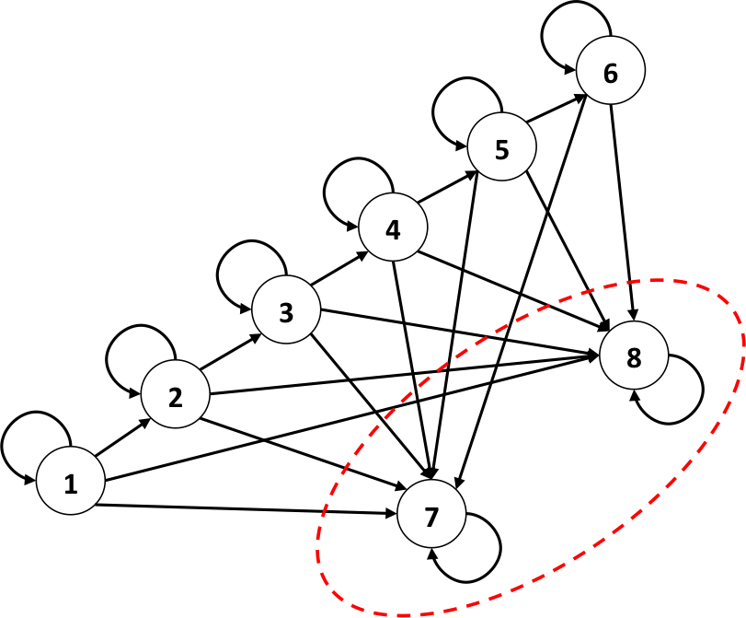
State Grouping
Introduction
Markov Chain Estimation
Dynamic Programming Retention Model
Future Research
States / Transition Matrix
Transition Probabilities
Validation / Bootstrap C.I.
Interpretation of the Markov Process

Slide 9
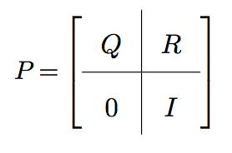
Matrix Estimation Properties
Introduction
Markov Chain Estimation
Dynamic Programming Retention Model
Future Research
States / Transition Matrix
Transition Probabilities
Validation / Bootstrap C.I.
Interpretation of the Markov Process

Slide 10
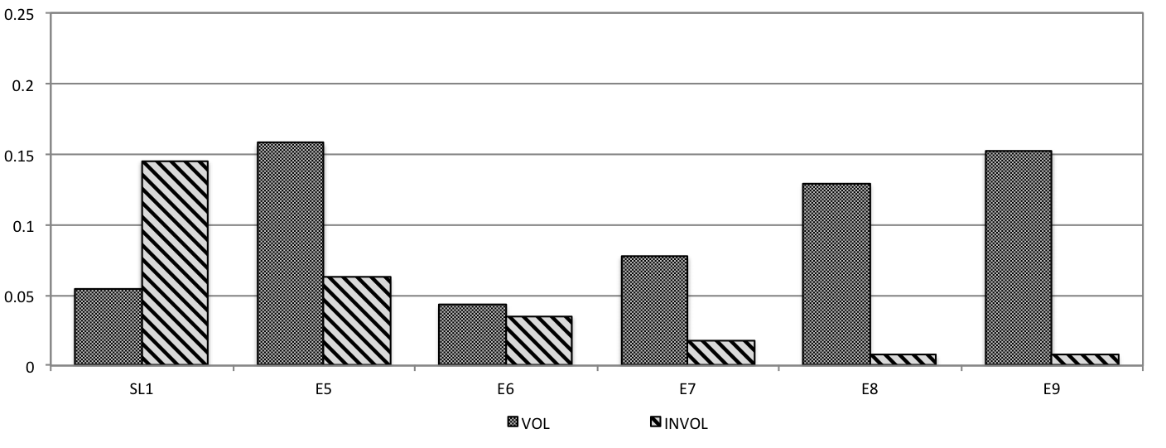
Transition Probabilities
Introduction
Markov Chain Estimation
Dynamic Programming Retention Model
Future Research
States / Transition Matrix
Transition Probabilities
Validation / Bootstrap C.I.
Interpretation of the Markov Process
There are four categories of transition probabilities:
Promotion to the next grade
Continuation in the same grade
Voluntary separation from military service
Involuntary separation from military service
Transition probabilities are constructed from Total Army Personnel Database (TAPDB) extracts from fiscal years 2007-2009.
Comparison of loss probabilities in a single period by grade

Slide 11
Validation
Introduction
Markov Chain Estimation
Dynamic Programming Retention Model
Future Research
States / Transition Matrix
Transition Probabilities
Validation / Bootstrap C.I.
Interpretation of the Markov Process

Slide 12
Bootstrapping Confidence Intervals
Introduction
Markov Chain Estimation
Dynamic Programming Retention Model
Future Research
States / Transition Matrix
Transition Probabilities
Validation / Bootstrap C.I.
Interpretation of the Markov Process

Slide 13
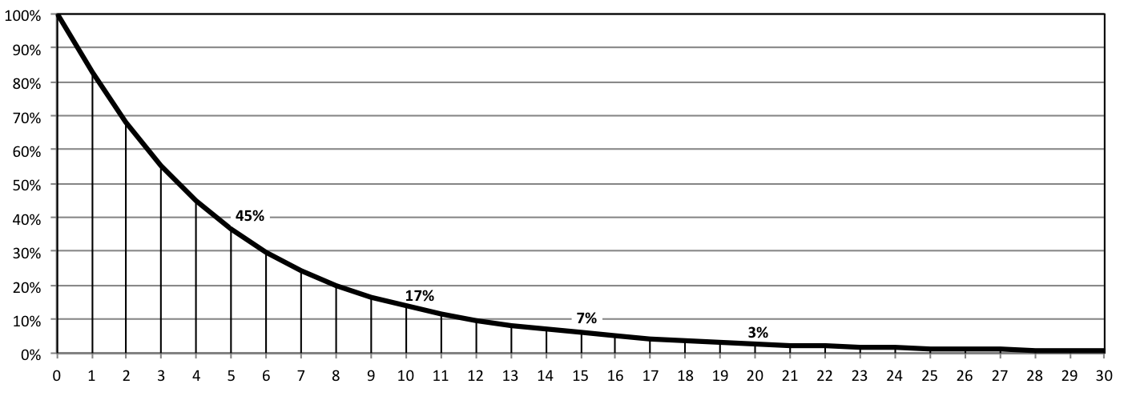
Interpretation of the Fundamental Matrix
Introduction
Markov Chain Estimation
Dynamic Programming Retention Model
Future Research
States / Transition Matrix
Transition Probabilities
Validation / Bootstrap C.I.
Interpretation of the Markov Process

Slide 14
Interpretation of Absorption Probabilities
Introduction
Markov Chain Estimation
Dynamic Programming Retention Model
Future Research
States / Transition Matrix
Transition Probabilities
Validation / Bootstrap C.I.
Interpretation of the Markov Process

Slide 15
Interpretation of Transition Probabilities
Introduction
Markov Chain Estimation
Dynamic Programming Retention Model
Future Research
States / Transition Matrix
Transition Probabilities
Validation / Bootstrap C.I.
Interpretation of the Markov Process

Slide 16
Notation
Introduction
Markov Chain Estimation
Dynamic Programming Retention Model
Future Research
Notation
Reward and Value Functions
Optimal Policy Index
Integration with Predictive Model

Slide 17
Estimating Civilian Pay
Introduction
Markov Chain Estimation
Dynamic Programming Retention Model
Future Research
Notation
Reward and Value Functions
Optimal Policy Index
Integration with Predictive Model

Slide 18
Reward and Value Functions
Introduction
Markov Chain Estimation
Dynamic Programming Retention Model
Future Research
Notation
Reward and Value Functions
Optimal Policy Index
Integration with Predictive Model

Slide 19
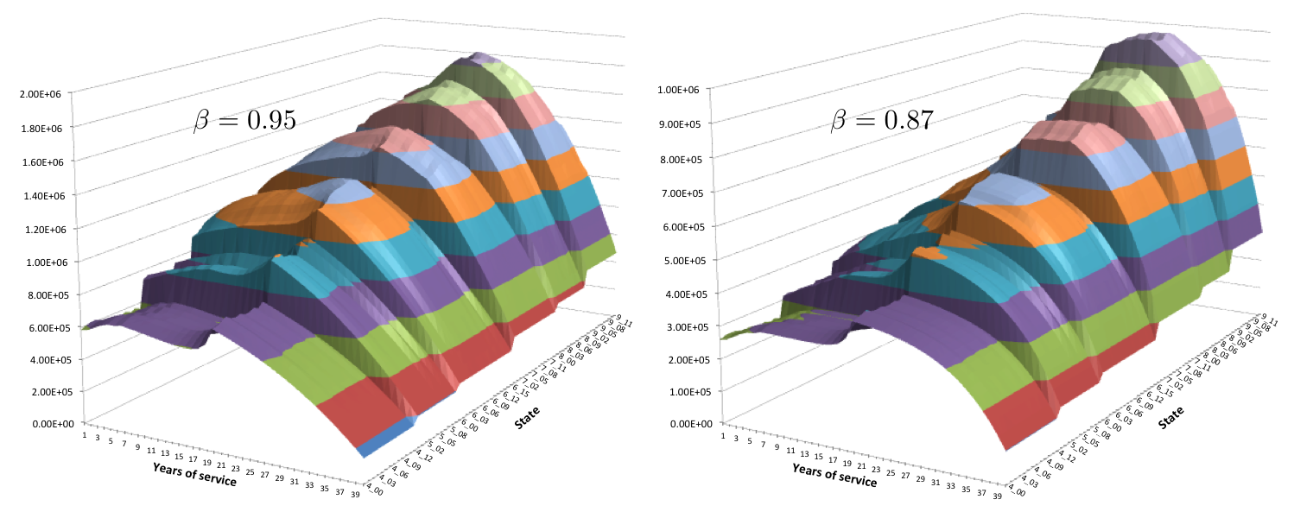
Value Plot
Introduction
Markov Chain Estimation
Dynamic Programming Retention Model
Future Research
Notation
Reward and Value Functions
Optimal Policy Index
Integration with Predictive Model
Assumes the average age of entering the military is 22 years, the expected life expectancy of an individual is 75 years, and the total time an individual works in the military and civilian sector is 40 years.

Slide 20
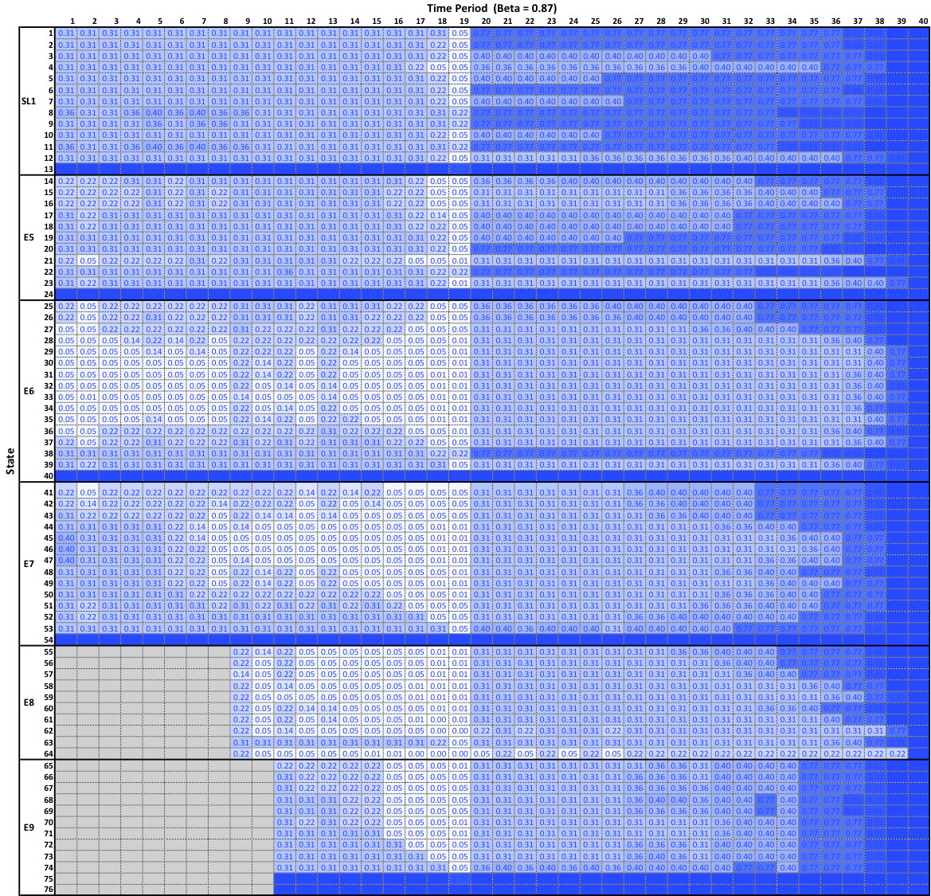
Optimal Policy Index
Introduction
Markov Chain Estimation
Dynamic Programming Retention Model
Future Research
Notation
Reward and Value Functions
Optimal Policy Index
Integration with Predictive Model
The optimal policy index provides a empirical ratio for the stay-or-leave decision such that as the value closer to 1 indicates a stronger leave index.

Slide 21
Logit and Index
Introduction
Markov Chain Estimation
Dynamic Programming Retention Model
Future Research
Notation
Reward and Value Functions
Optimal Policy Index
Integration with Predictive Model

Slide 22
Future Research
Introduction
Markov Chain Estimation
Dynamic Programming Retention Model
Future Research
Improvements to expected compensation estimates based on skill and experience.
Optimization of incentives
Determine an optimal retention policy that initially targets individuals with grade, TIG and TIS combinations most likely to be influenced by financial incentive.
Identify and prescribe optimal incentive values that will change the stay or leave decision of targeted individuals.

Slide 23
Introduction
Markov Chain Estimation
Dynamic Programming Retention Model
Future Research
Questions

